Slide 1


Slide 2


25% Discount on Kitchen and bathroom Remodel

Slide 3
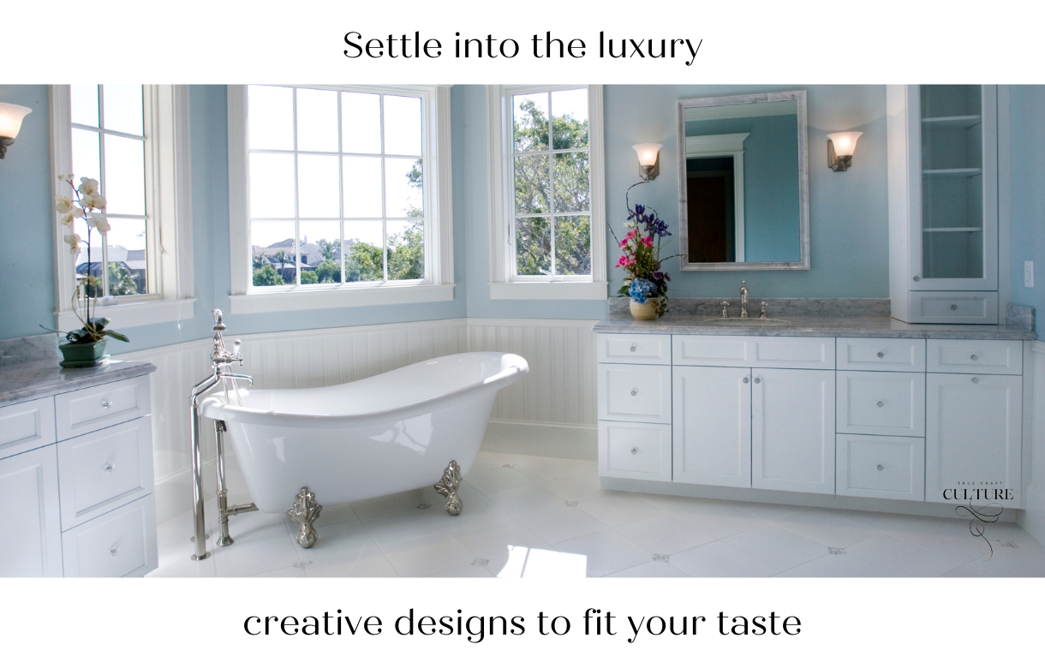

Slide 4
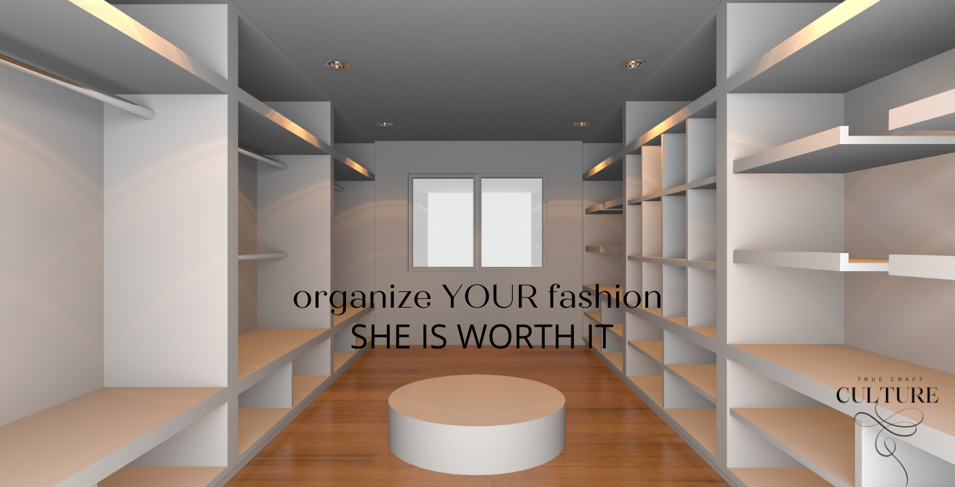

Slide 5


Slide 6


